Slide 1
Noise Filtering in Monte Carlo Rendering
Jung-Ho Kim
CS580 Student Presentation
May 3, 2016
Notes:
Good Evening everyone. I’m Jung-Ho Kim. The title of today’s talk is ‘Noise Filtering in Monte Carlo Rendering’.

Slide 2
Brief review for previous talk
Photo-realistic Renderings for Machines (SHK)
  Stochastic sampling strategies
  Gaussian jittered sampling
  Application: Viewpoint estimation in images
    CNN
Physically-Based Real-Time Lens Flare Rendering (KHL)
  Ghost, Flare (Star, Rings)
  Acceleration and approximation of lens flare
  Practical approach: Linearization
Notes:
Before we go on today’s topic, I will give a brief review for previous talk.
The first presenter is Seong-Heum Kim. He talked about photo-realistic Renderings for Machines.
There are some stochastic sampling strategies for assessing bias and variance in integration which is used for Monte Carlo estimator.
Gaussian jittered sampling is one of the strategies and it showed the lowest variance of the Monte Carlo Integration.
And he presented one of the applications for estimating 3D viewpoints in image by using CNNs trained with images rendered from 3d models.
The second presenter KeunHong covered real-time lens flare rendering. He explained a phenomena about ghost and types of flare. He provided strategies for acceleration and approximation to render in real time.

Slide 3
Objectives
Understand the high-level concept of
  Random Parameter Filtering (RPF)
  Non-Local Means Filtering (NLM)
Compare the characteristics of RPF and NLM.
  Error metric
  Filtering method
  Pros and cons
Notes:
After this talk, you can achieve these things which I hope? Lol
So you can understand ~. And you can compare the characteristics of random parameter filtering and non-local means filtering. So you will know what kind of error metric and filtering method are used for their approaches and their pros and cons.

Slide 4
Presentation papers
Sen and Darabi, “On Filtering the Noise from the Random Parameters in Monte Carlo Rendering”, SIGGRAPH 2011
Rousselle et al., “Adaptive Rendering with Non-Local Means Filtering”, SIGGRAPH Asia 2012
Notes:
Here are the papers to be covered in this talk.

Slide 5
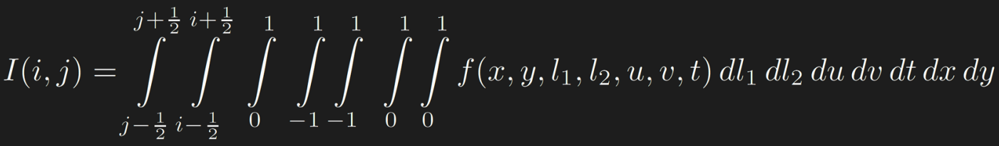
Key observation
MC noise occurs when sample values are functions of random parameters of MC system
random parameters
Notes:
Here is key observation. MC noise occurs when sample values are functions of random parameters of MC system. In other words, The noise in the image can be derived from Monte Carlo rendering.
Let’s assume that this equation estimates the color of the pixel in the image. To estimate the color, we calculate this multidimensional integrals. F is functional representation of the color system and a set of random parameters are given. In this case, parameters can be world space coordinates, surface normals and texture.
You don’t need to understand the details of this equation now. Just know that some features in the scene can be given as parameter for rendering function.
F is called black box. I will give details of this equation very soon.

Slide 6
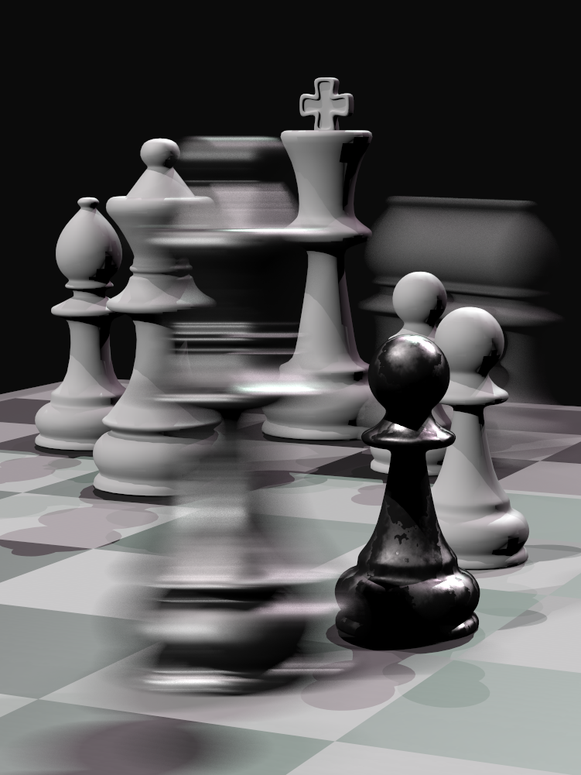
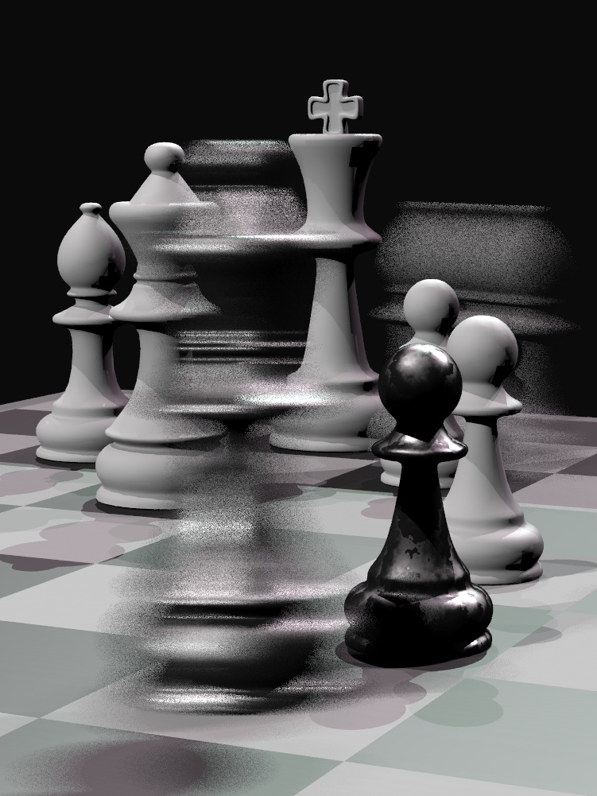
Example
scene by Wojciech Jarosz
1,024 samples/pixel
16 samples/pixel
Notes:
Here is an example image. When we sample about a thousand times for a pixel. It has very few noise.
But if sampling rate is dropped to sixteen times. You can easily find the noise in the image.

Slide 7


Related work: Filtering/reducing MC noise
Multidimensional Adaptive Sampling (Hachisuka et al., 2008)
Adaptive Wavelet Rendering (Overbeck et al., 2009)
$\grave{A}$-Trous (Dammertz et al., 2010)
scenes from Sen and Darabi’s report paper
MDAS (8 spp)
AWR (8 spp)
$\grave{A}$-Trous (8 spp)
Notes:
There are previous work done by researchers.
Hachisuka et al. proposed multidimensional adaptive sampling algorithm, which adaptively samples the space in all parameter dimensions.
It can handle a wide range of Monte carlo effects but suffer from the curse of dimensionality.
Overbeck et al. proposed another general method called adaptive wavelet rendering
This algorithm smooths noisy areas and preserves details.
Dammertz et al. proposed the edge avoiding filtering methods. This algorithm uses world position and normal vector to help identify edges in the scene.

Slide 8
Random Parameter Filtering (RPF)
Notes:
Now, let’s have a look at random parameter filtering.

Slide 9
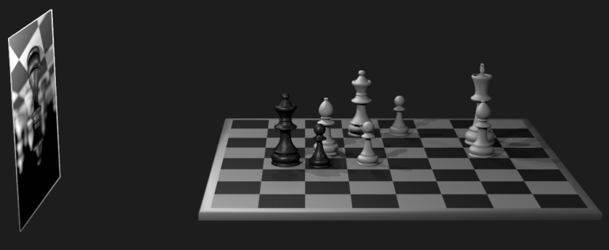
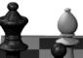
Key idea
Establish statistical dependency between sample values and random parameters
f(x,y,u,v)
(u,v)
(x,y)
Notes:
A key idea in random parameter filtering is that by determining how the values of the sample statistically dependent on random parameters. By doing this we can filter out the Monte Carlo noise.
Let’s see a simple example.
Here’s a scene that we want to render with the depth of field value.
To render a pixel x, y, we integrate the radiance over the lens.
Monte carlo rendering system selects random points on the lens
And sums up the contributions of the radiance through each of these points

Slide 10

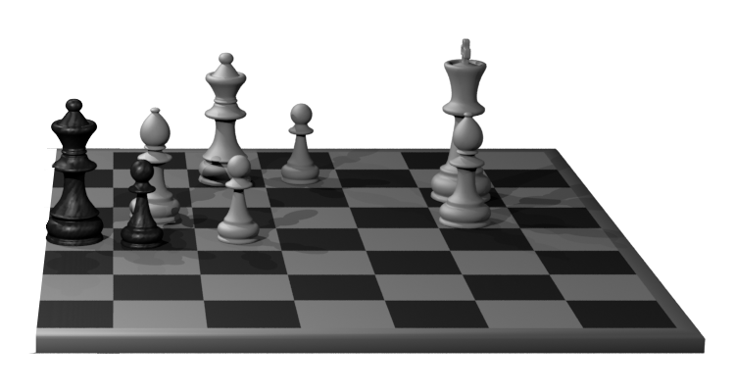

Depth of Field (DoF)
focal plane
image plane
scene
lens
Color of the ray is not dependent on value of on the lens
Color differences between pixels are scene features, not MC noise
Notes:
Any ray through the ray from this pixel will land on the same region at the scene regardless of the point of the region.
It means the color of the ray is not dependent on value of (u,v) on the lens.
So monte carlo noise do not affect the final color at all.
Therefore, we know this region is focused.

Slide 11

Depth of Field (DoF)
focal plane
image plane
scene
lens
Color of the ray depends on
the value of on the lens
Color differences between pixels are Monte Carlo noise not scene detail
Notes:
For pixel out of a focus on the other hand, the position of random point on the lens affects the final color of the sample.
It means scene detail does not affect color at all.
Which is why these regions look noisy.
Therefore, we should filter more heavily in this region to reduce the noise.

Slide 12
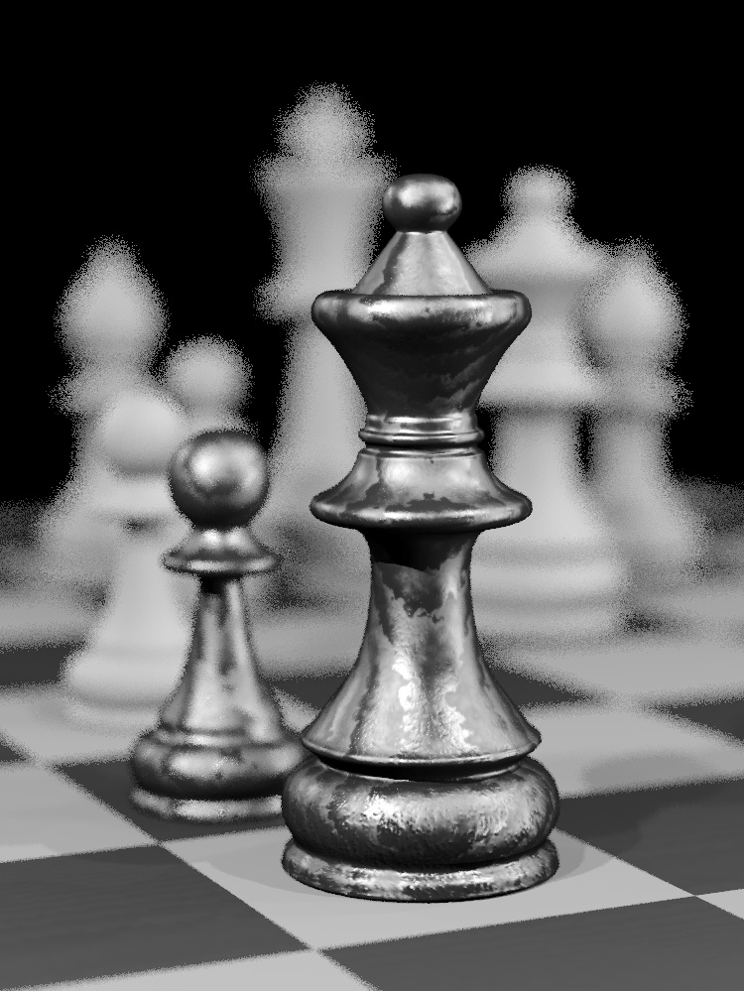
Depth of Field (DoF)
scene by Wojciech Jarosz
8 samples/pixel
Notes:
Here is a rendered image computed by a small number of sampling say 8.
You can see the difference between green region which is more focused and red region.

Slide 13
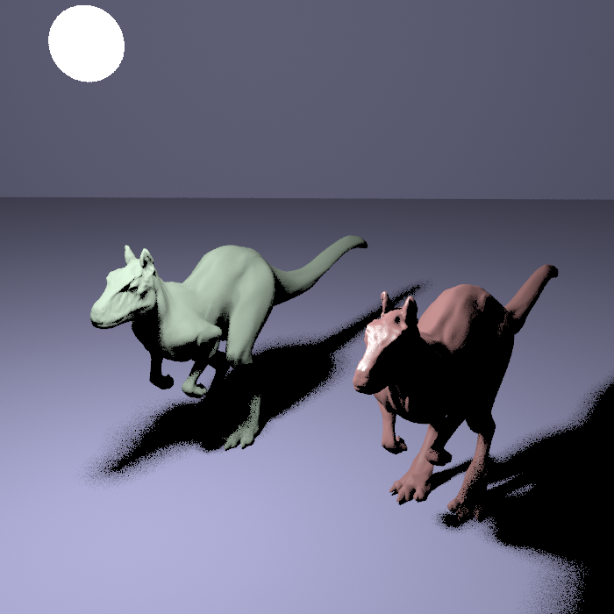
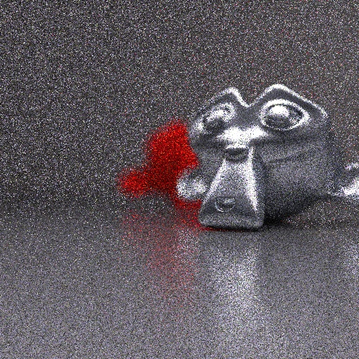
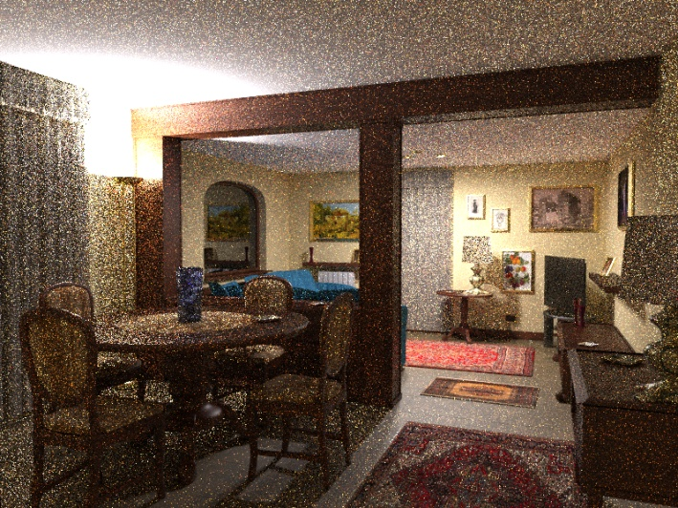
This works for other effects
Area light sources
Glossy reflections
Path-tracing
models by headus/Rezard
Blender distribution scene
scene by Luca Cugia
Notes:
This algorithm works well for general monte carlo effects such as
Area light sources
Glossy reflections
And path tracing

Slide 14
Key observations
MC noise occurs only where sample values are functions of MC random parameters
The challenge: how do we identify where this is
happening in a general scene from just a few samples?
Notes:
So now we know the key idea of random parameter filtering.
But is it really work just in a small samples?
How random parameter filtering generally works with other features in the scene?

Slide 15
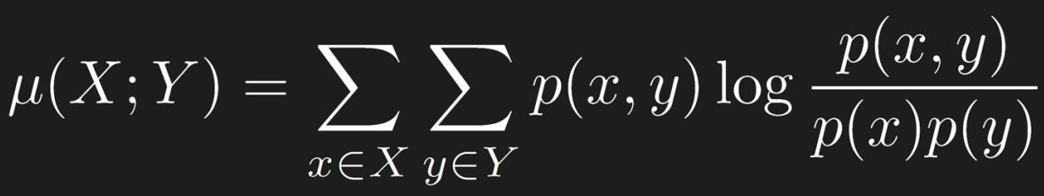
Estimating functional dependency
We use mutual information from information theory:
Measure of statistical dependency between two
random variables
Notes:
Now let’s focused on the details of random parameter filtering.
To establish the statistical dependency between sample values and random parameters,
Random parameter filter adopts mutual information function.

Slide 16
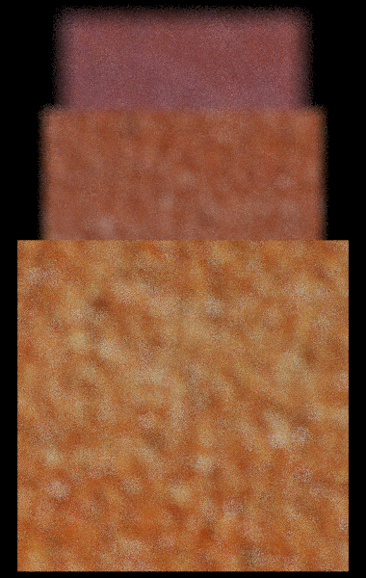
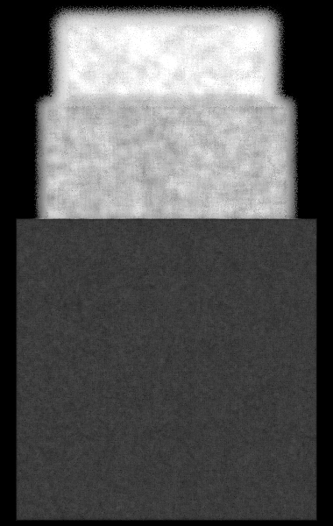
Using mutual information
Detects the dependency of the color on the lens
position for our simple example
bright: high statistical dependency
dark: low statistical dependency
dependency of color
on lens position (u,v)
8 samples/pixel
Notes:
By using mutual information equation,
We can detect the dependency of the color on the lens position.
Here is an example.
The bright side has much noise than dark side which means this region has high statistical dependency with random parameters.

Slide 17
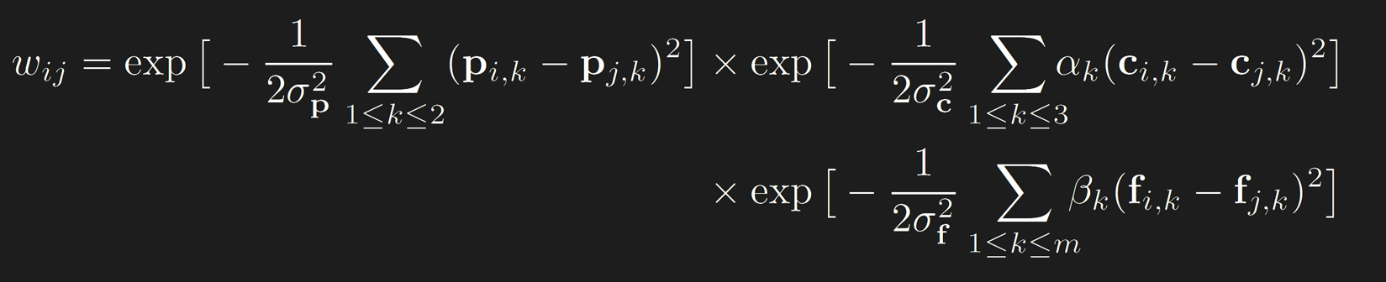


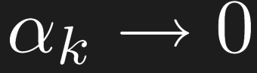
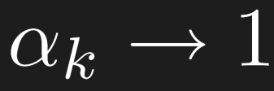
Random Parameter Filter (RPF)
Modify bilateral filter using mutual information to control impact of color channels
If color is very dependent on random params,
it is noise: set (ignore color differences to filter noise)
If color is not dependent on random params,
set (preserve scene detail)
Notes:
To apply this concept, we need to modify bilateral filters. Alpha term is multiplied on the original color variances.
And If color has a strong dependency between random parameters, the influence of original color variances should be ignored. So we need to set alpha to 0.
On the other hand, we set alpha to 1 because it does not have noise.

Slide 18
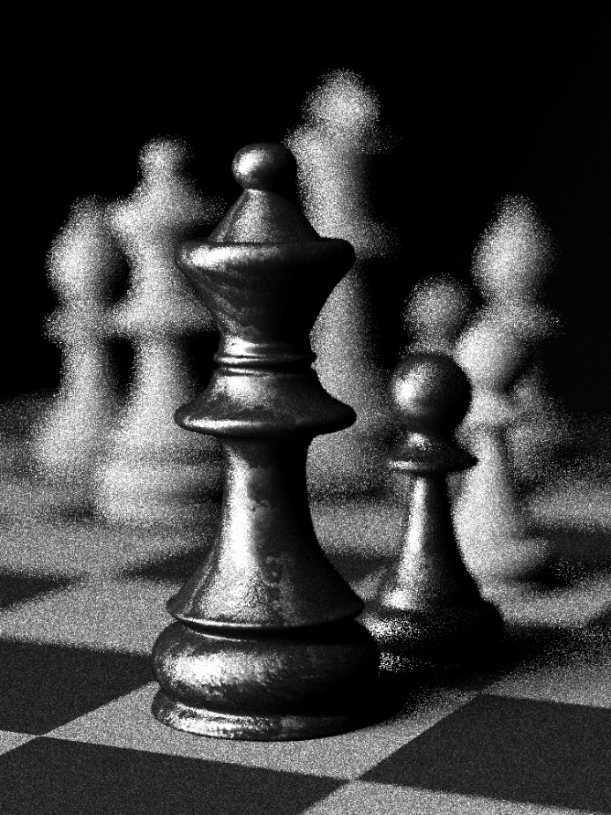
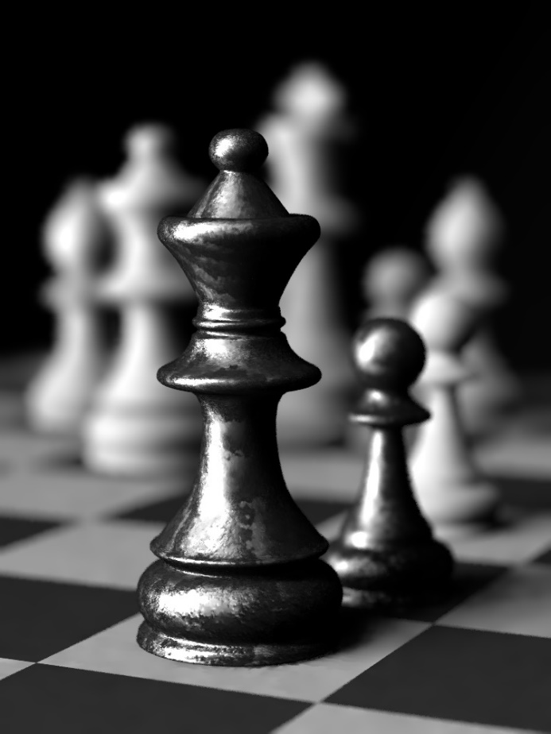
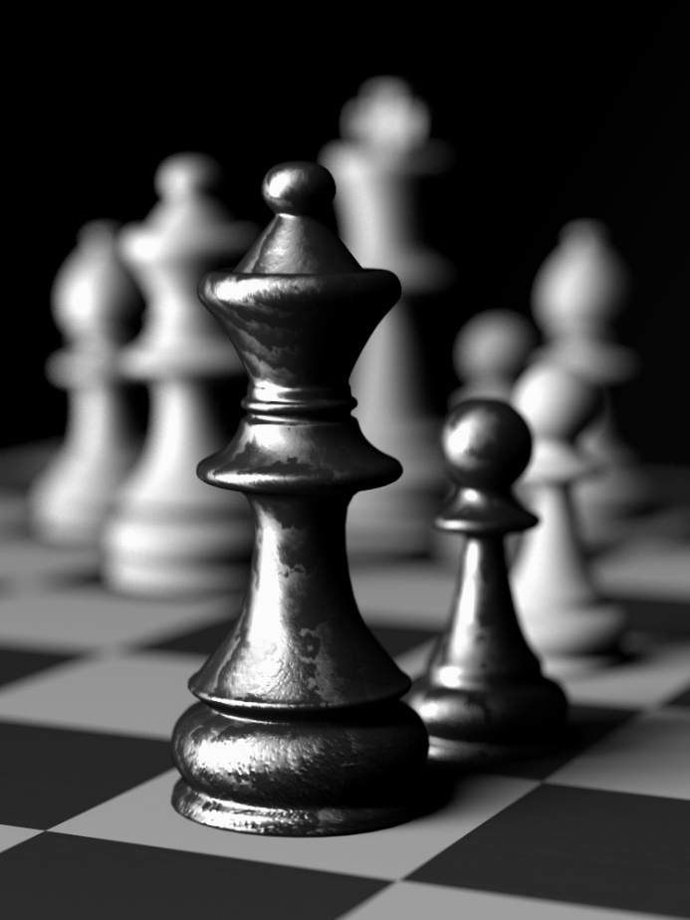
Result: Chess scene (DoF + area light)
scene by Wojciech Jarosz
input rendering (8 spp)
7.13 secs
RPF (8 spp)
4.9 mins
reference (8,192 spp)
1.2 hrs
Notes:
Now let’s see the result of random parameter filtering.
input image with 8 samples per pixel takes about 7 seconds.
And high-quality image which can be called reference takes more than one hour.
But this comparable image takes about 5 minutes.
It looks like reference image though it takes 8 samples per pixel.

Slide 19
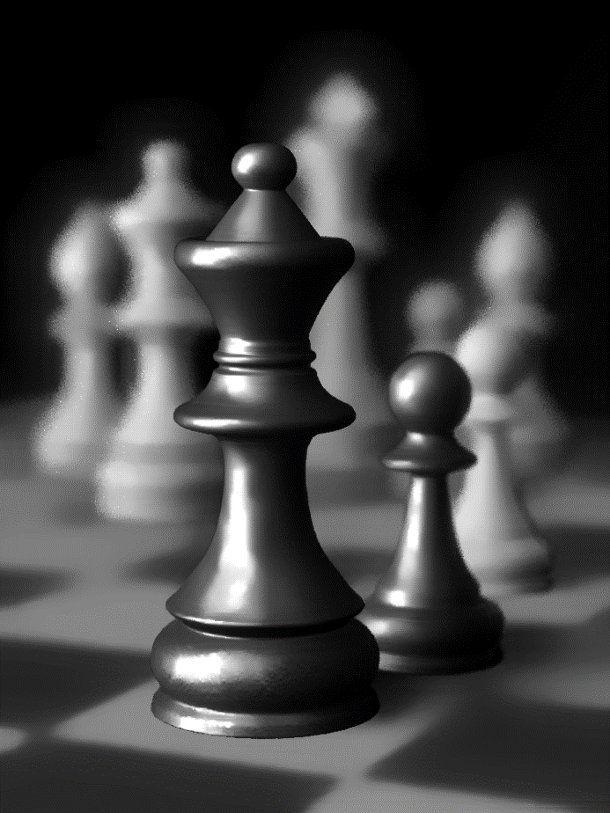
Result: Chess scene (DoF + area light)
scene by Wojciech Jarosz
À-Trous filter (8 spp)
Dammertz et al. [2010]
our result (8 spp)
reference (8,192 spp)
Notes:
RPM preserves the material details better than previous work because it do not assign physical meaning to the random parameters.

Slide 20



Result: Toy Gyro scene
scene by Jesper Lloyd
input (8 samples/pixel) 76 secs
our result (8 samples/pixel) 15.9 mins
reference (8,192 samples/pixel) 20 hrs
Notes:
So it works for a wide range of monte carlo effects.
Including motion blur, path-tracing and Russian roulette.

Slide 21
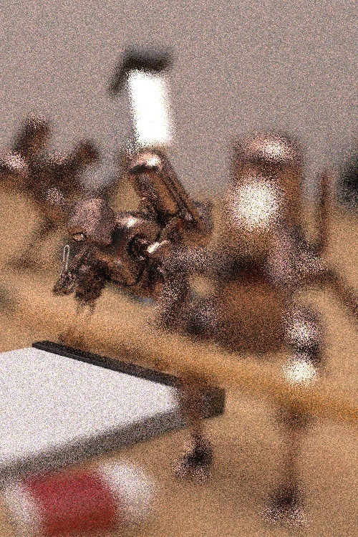
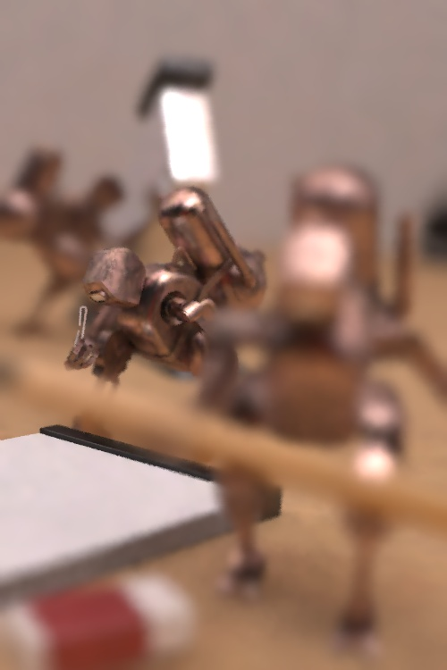
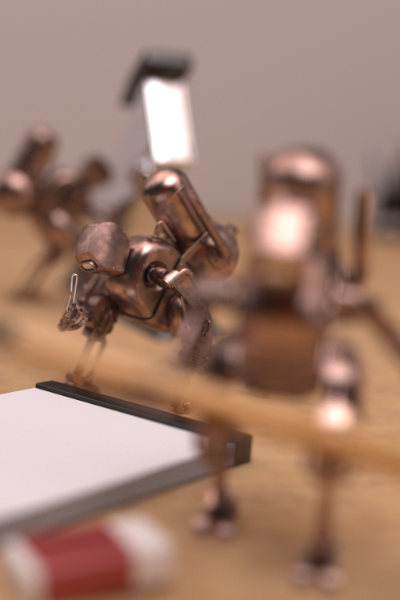
Result: Robots scene
scene by Jesper Lloyd
input (8 samples/pixel)
15 secs
our result (8 samples/pixel)
1.7 mins
reference (8,192 samples/pixel)
4 hours

Slide 22
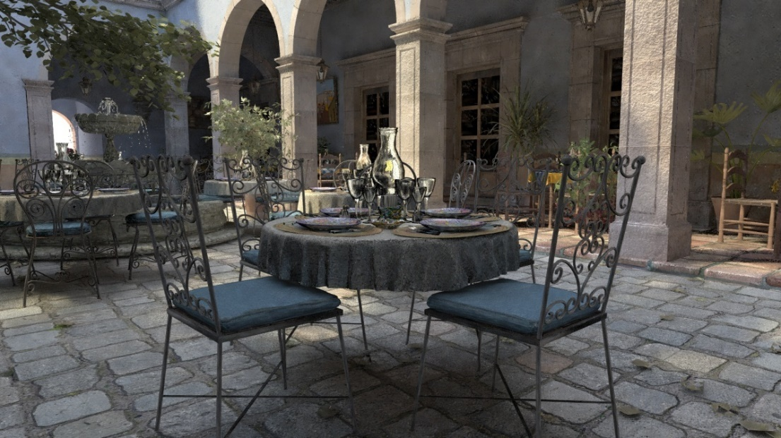
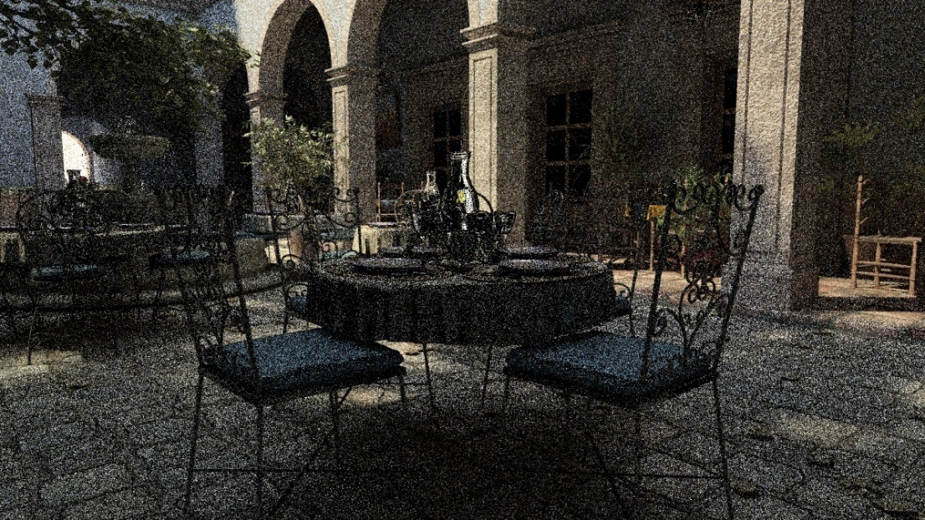
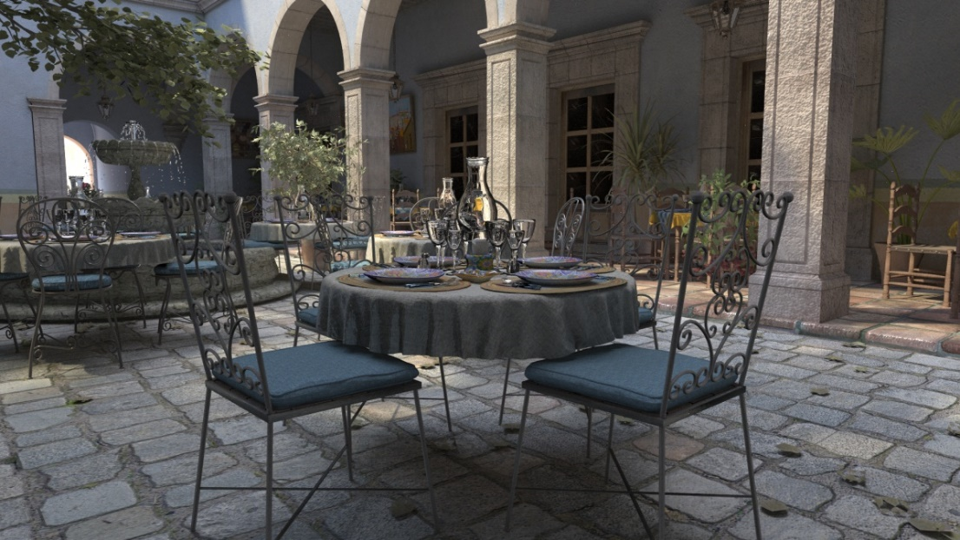
Result: San Miguel scene
scene by M. Leal Llaguno
input (8 samples/pixel) 1.8 mins
our result (8 samples/pixel) 14.8 mins
speed up of 100x
reference (8,192 samples/pixel) 24.3 hrs
Notes:
And for this result, It is hundred time faster than reference.

Slide 23
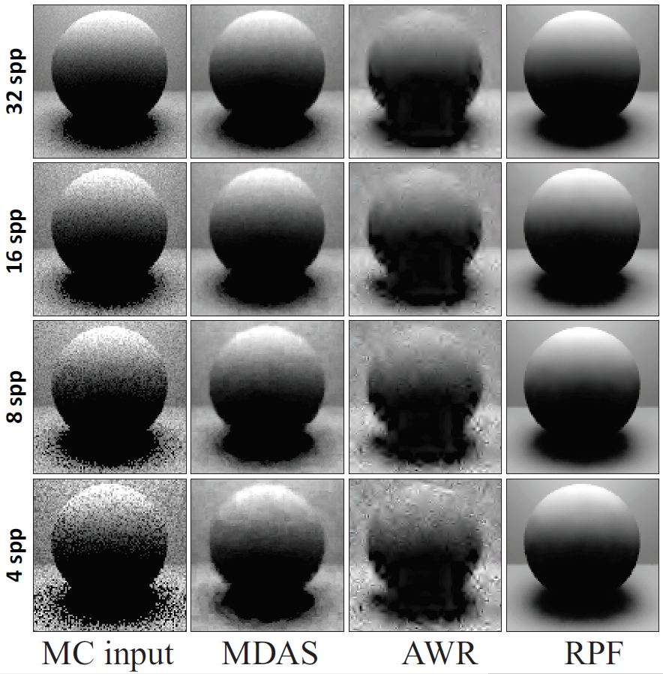
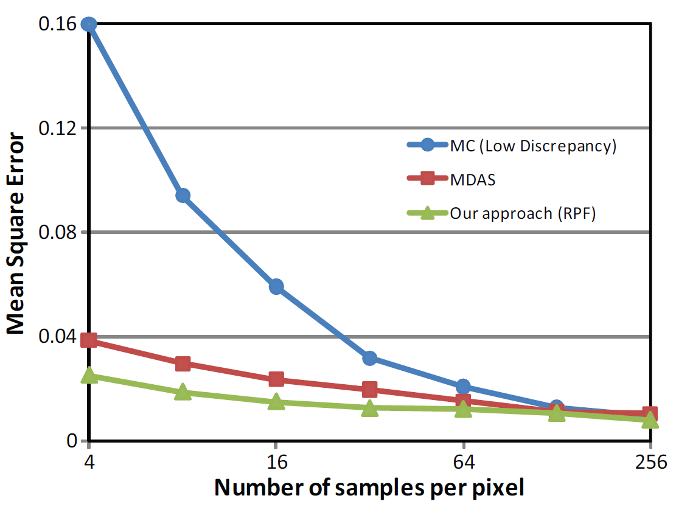
MSE comparison
Notes:
Also we want to compare the quality of output images. This graph shows that random parameter filtering algorithm converges to the standard Monte carlo with a large number of samples.

Slide 24
Non-Local Means Filtering (NLM)
Notes:
That’s the end of random parameter filtering.
Now let’s see non-local means filtering.

Slide 25
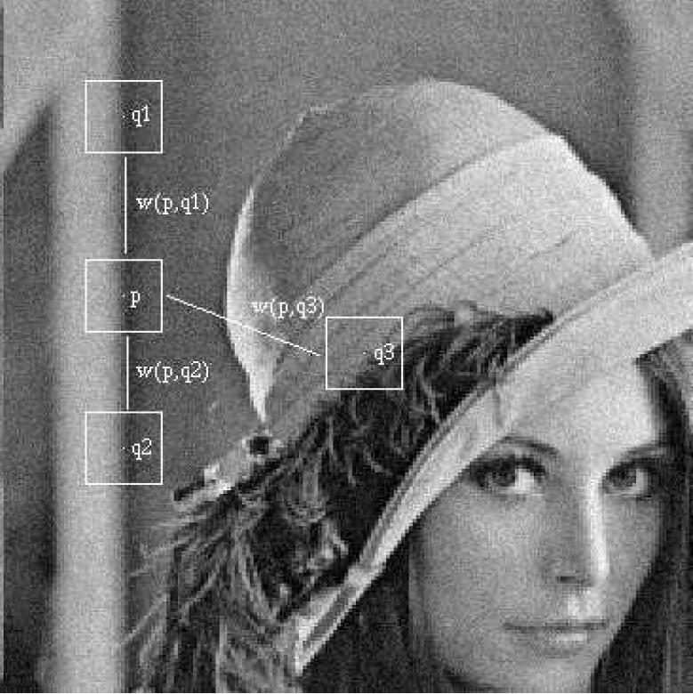



Non-Local Means Filtering (NLM) (1/2)
NLM is suggested by Buades et al. in 2005.
$$\hat{u_{i}}\left(p\right)=\frac{1}{C\left(p\right)}\sum_{q∈Near P}{u_{i}\left(q\right) w(p, q)}$$
Variance-dependent term
scene by Buades et al.
$$w\left(p, q\right)=\exp^{−\frac{max\left(0, {distance\left(p, q\right)}^{2} −2σ^{2}\right)}{k^{2}2σ^{2}}{ }}$$
$$High{ σ}^{2}→Small w\left(p, q\right)$$
$$Low{ σ}^{2}→Large w\left(p, q\right)$$
Notes:
Non-Local Means Filtering (NLM) reduces noise
by weighting all pixels in the image based on the variance.
To understand this formula, let’s see a simple image.
If variance of between patch p and q is high, then weight between them is small.
On the other hand, variance is low, weight between them will be large.
So, the weight of patch q1 and q2 will be large because they are similar to patch p.
But, q3 have low similarity with p. So, its weight would be small.

Slide 26
Non-Local Means Filtering (NLM) (2/2)
Original Non-Local Means Filter
Modified NLM (Symmetric Distance)
$$distance \left(p, q\right)=\frac{{(color\left(p\right)−color\left(q\right))}^{2} −(Var\left[p\right]+Var\left[p,q\right])}{Var\left[p\right]+Var\left[q\right]}$$
$$distance \left(p, \overline{q}\right)=\frac{{(color\left(p\right)−color\left(\overline{q}\right))}^{2} −(Var\left[p\right]+Var\left[p,\overline{q}\right])}{Var\left[p\right]+Var\left[\overline{q}\right]}$$
Notes:
To understand more detail, lets compare this distance equation.
You saw the distance term from the previous slide.
As you see, the main difference between these is q.
Modified non-local means filtering use the mean value of pixels.
The original non-local means filtering algorithm is constrained to neighbors which is orthogonal to the gradient directions.
So, modified one can resolve this phenomena.

Slide 27
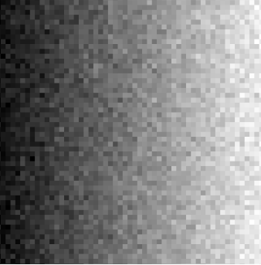
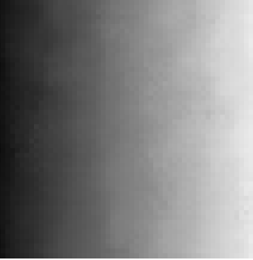


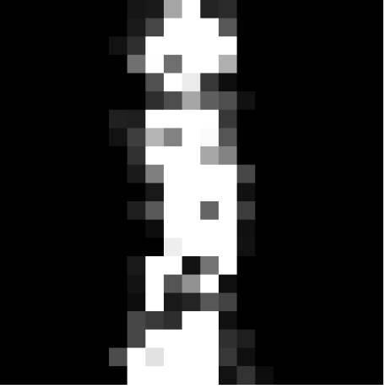
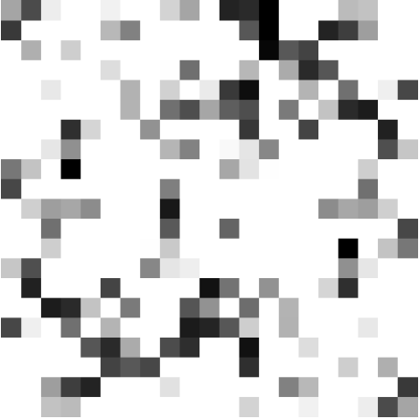
Original vs Modified NLM
Noisy data
Original
Symmetric
MSE: 2.546E-3
MSE: 0.122E-3
MSE: 0.034E-3
Notes:
As I noticed before, original NLM gets more error.
Symmetric NLM gets more smooth result than standard NLM.

Slide 28
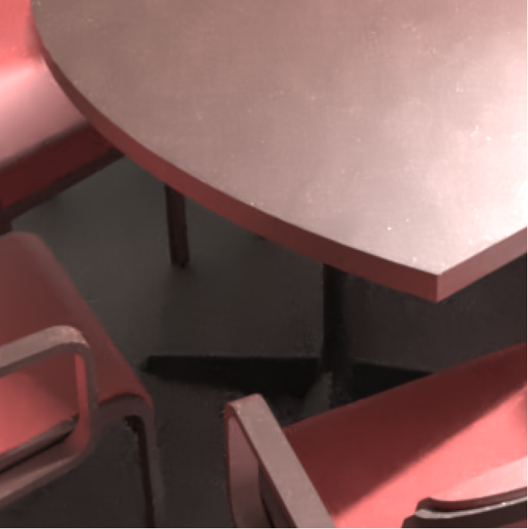


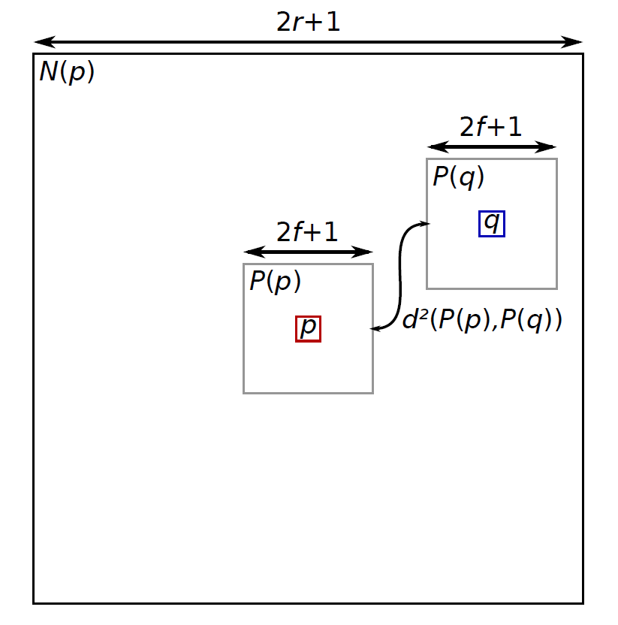




Result
$$r:window size$$
$r=30$ , MSE: 1.722E-3
$r=10$ , MSE: 2.292E-3
$r=20$ , MSE: 1.809E-3
Notes:
Here are the rendering result using varying filter window size.
You need to pay attention to recognize the difference.
When a small window size is given, the contributions to their neighborhoods are not sufficiently spread out. And yield high MSE.

Slide 29
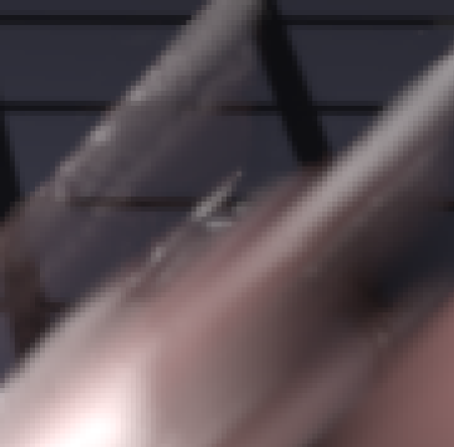
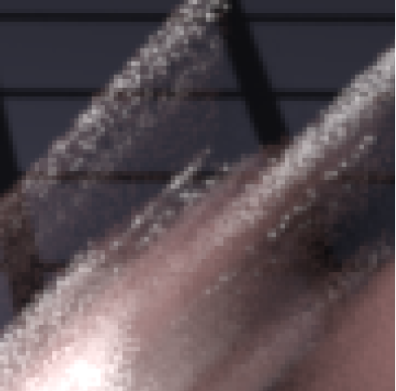
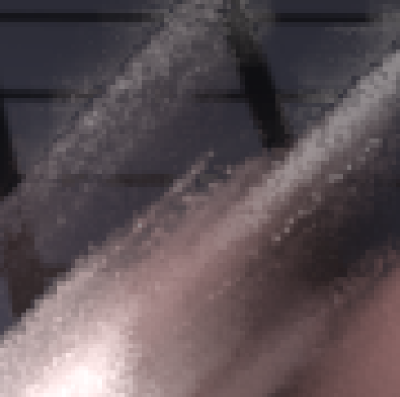




Result
$$f:patch size$$
$$Uniform Sampling, 64 spp$$
MSE: 0.706E-3
$$f=0 (Bilateral Filtering)$$
MSE: 0.786E-3
$f=3$ , MSE: 0.218E-3
Notes:
Now let’s compare rendering result depending on patch size.
If patch term f is 0, then this result is same as bilateral filtering.
If patch size is sufficient enough, we can get significantly upgraded image.

Slide 30
RPF vs NLM
Method | Adaptive | Metric | Reconstruction
RPF | Reconstruction only | Mutual Information | Bilateral Filtering
NLM | Sampling and Reconstruction | Variance | NL-means Filtering
pros and cons
  RPF is fast and naturally handles noisy features but the complexity of the algorithm is dependent on # samples.
  RPF does not try to minimize the output error directly.
  NLM outperforms RPF for typical cases because it selects filters according to error estimation.
  NLM is inefficient when noise comes from a small subset of the sampling domain (brute-force sampling).
  NLM does not keep geometry or texture detail.
Notes:
Let’s compare two algorithm.
Random parameter filtering randomly samples and adaptively reconstruct the image while non-local means filtering adaptively samples and reconstructs the image.
Random parameter filtering is quite fast algorithm and works well for general cases. But this algorithm can be expensive when the number of sample is high.
Also, random parameter filtering does not try to minimize the output error directly.
But non-local means filtering do. So, non-local means filtering outperforms random parameter filtering for most cases.
Since it is brute-force sampling algorithm, non-local means filtering is inefficient
And it cannot catch well the geometry or texture detail.

Slide 31
Summary
Random Parameter Filtering (RPF) uses statistical dependency between sample values and random parameters to filter MC noise.
Non-Local Means Filtering (NLM) reduces noise by weighting all pixels in the image based on the variance.
Both have their pros and cons.
Notes:
here is a summary.
Both algorithm approach differently for filtering monte carlo noise.
And They have their pros and cons.
But recently, improved algorithms are proposed. So anyone interested in this should catch up recent work.

Slide 32
Thank you!
Q & A

Slide 33

Quiz
Choose the keyword that is least related to Random Parameter Filtering (RPF).
  Statistical dependency
  Adaptive sampling
  Bilateral filtering
  Mutual information
What error metric is used in Non-Local Means Filtering (NLM)?
  MSE (SURE) b. $χ^{2}$ (chi-square)
  Variance d. Mutual information

Slide 34
Backup slides

Slide 35
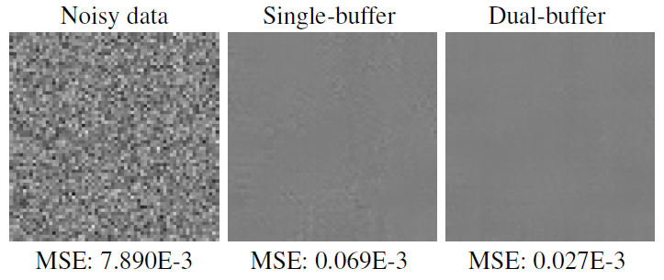
Dual-buffer Filtering (will be skipped)
Objective
  Eliminate the correlation between the filter weights and the noise.
To do so, maintain two image buffer A and B.
Use them to cross filter each other.

Slide 36
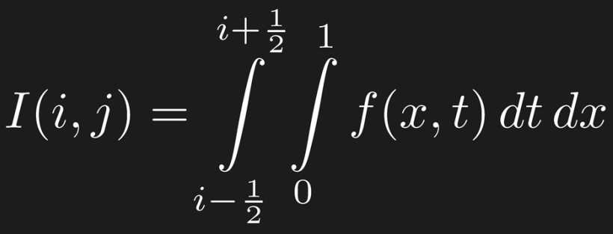




Simple illustration
t
1
0
x
i – 1/2
i + 1/2
i – 1/2
i + 1/2
Where varies with respect to , the random values for will produce
noise at the output
Where is constant with respect to , high frequency content at the
output is scene detail

Slide 37
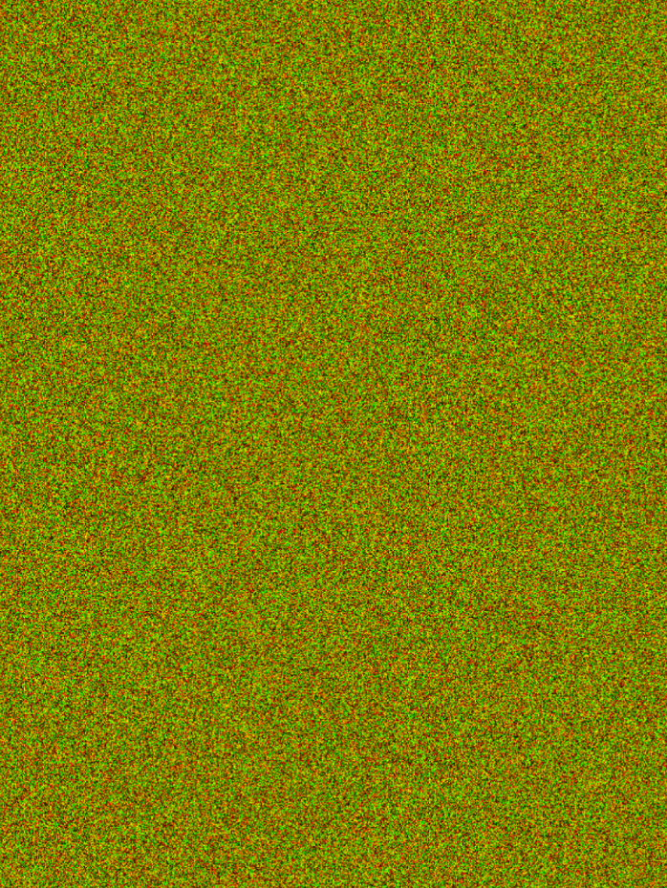


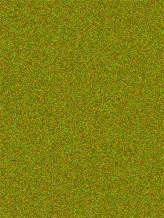
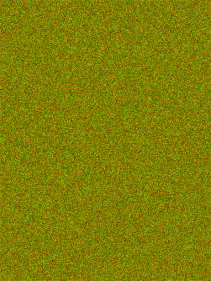
Formulation
To do this we treat the rendering system as a black box
(x,y)
scene function black box
f(x,y,u,v)
(u,v)
(x,y)
implemented by the rendering system
(u,v)
sample colors
functional dependency?
We need a way to estimate this functional dependency

